Slide 1


Online Crime Reporting
Presented By:
Pravinsinh Bhivaji Desai (229025)
Pratik Arvind Pathak (229055)t

Slide 2
Points to be discuss
Introduction
Motivation
Objectives
UML Diagrams
Disadvantages
Conclusion
Future Enhancement
References
Objectives
UML Diagrams
Objectives
UML Diagrams

Slide 3
Introduction
The web-based “Online Crime Reporting” project is an attempt to stimulate the basic concepts of the crime reporting system. There are three types of users(Role: Admin, Police Station, Complainant) who will be using this portal. The system enables the users to do the things such as register a complaint after login or register an emergency complaint in case of urgency to the region wise police station and then track the progress of complaint.

Slide 4
Motivation
Easy to access to end user to register there complaint as soon as possible.
No need to rush/travel for register complaint.
As per time save purpose(travel to police station and let know police about crime)
Centralized crime management system.
To every user easily available and accessible.

Slide 5
Objectives
people can easily report crime online.
Criminal details in a centralized database.
Can help in storing the records related to the criminals, cases, complaint record, case history and so on.
Easy operations for the operator of the system. User interfaces are user accommodating and attractive; it takes very less time for the operator to use the system.

Slide 6


Technology Used For Making Project
Front End: React.
Back End: Java Spring Boot API.

Slide 7
UML Diagrams

Slide 8
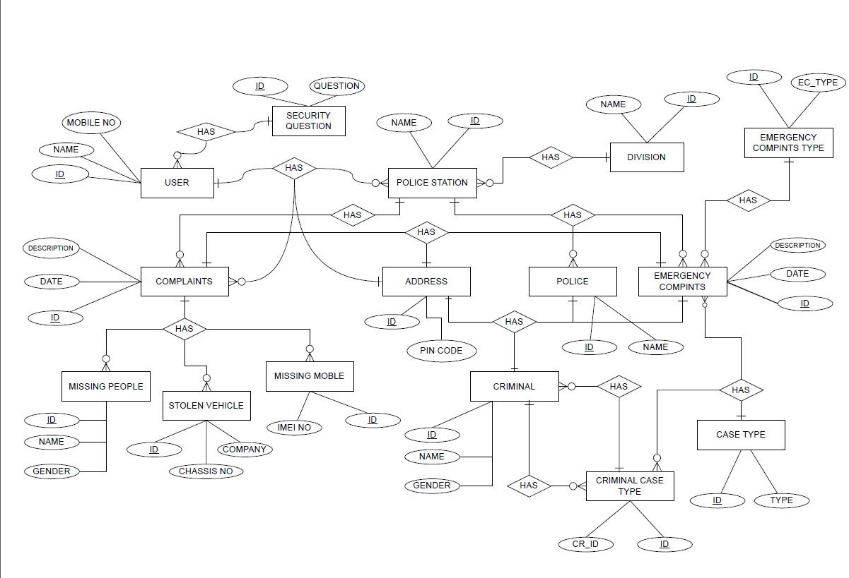
ER Diagram

Slide 9
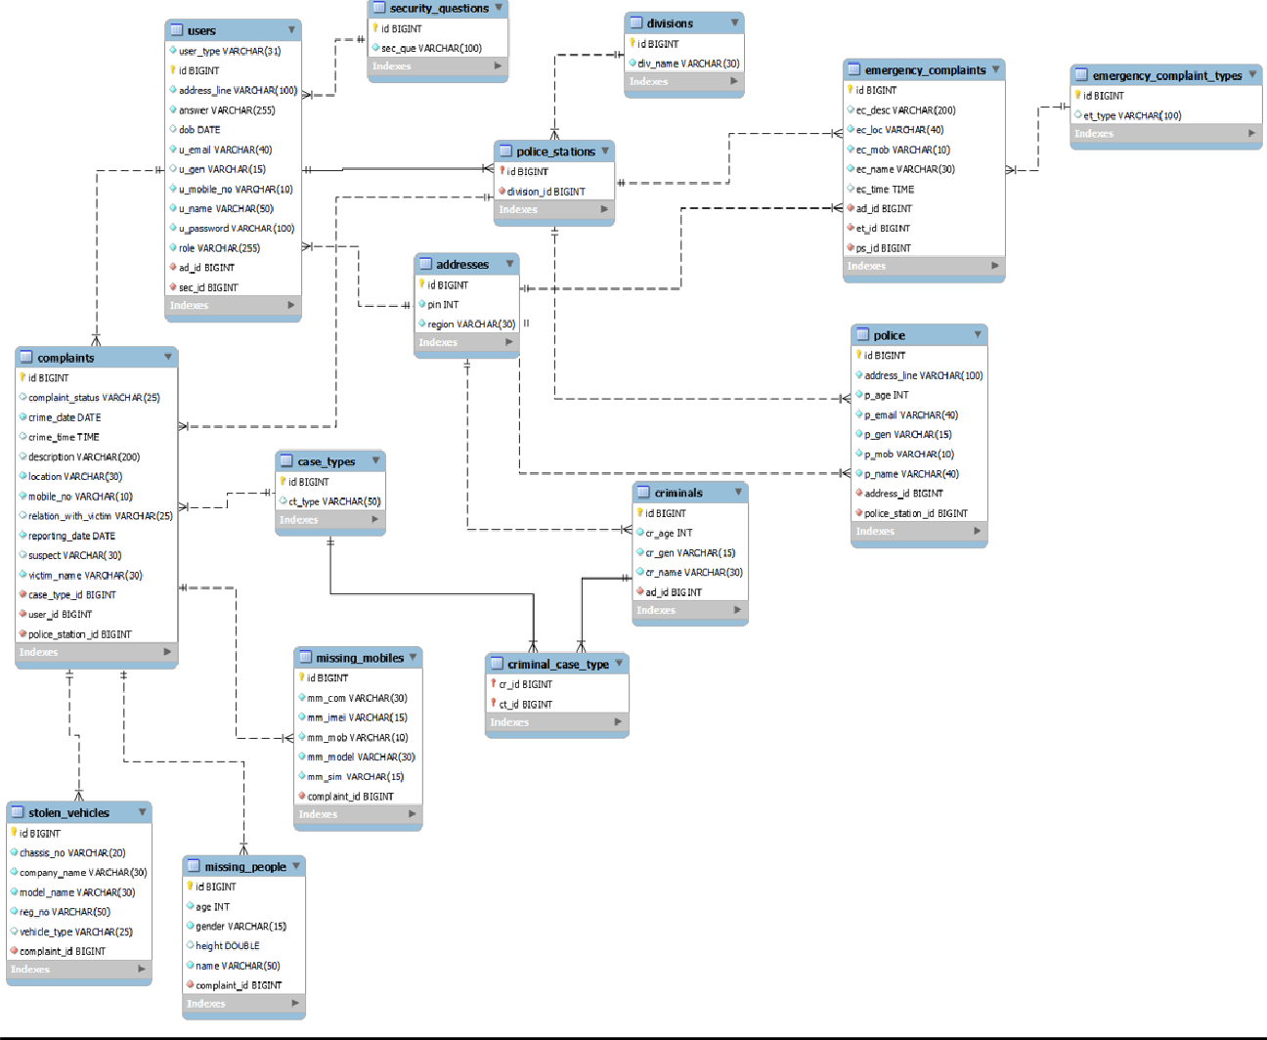
System Generated ER Diagram

Slide 10
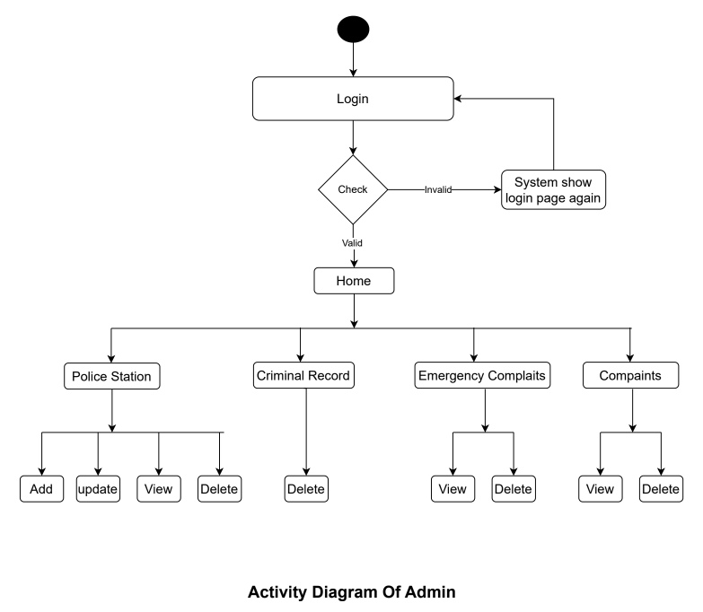
Activity Diagram OF Admin

Slide 11
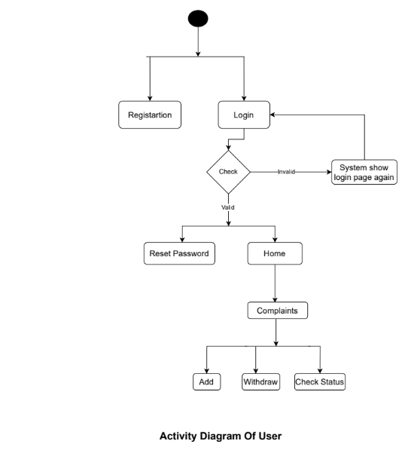
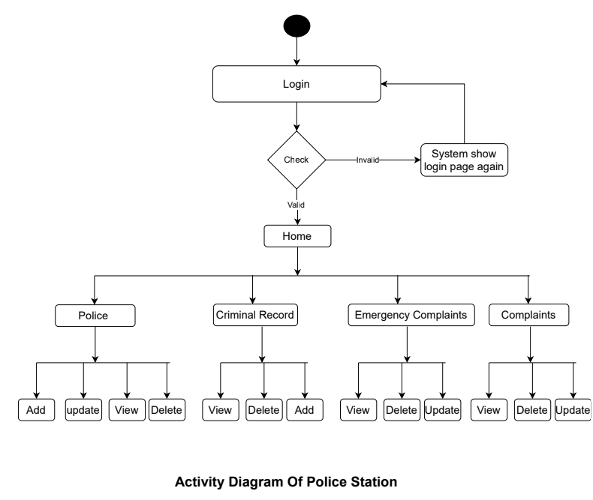
Activity Diagram Of Police Station
Activity Diagram Of User

Slide 12
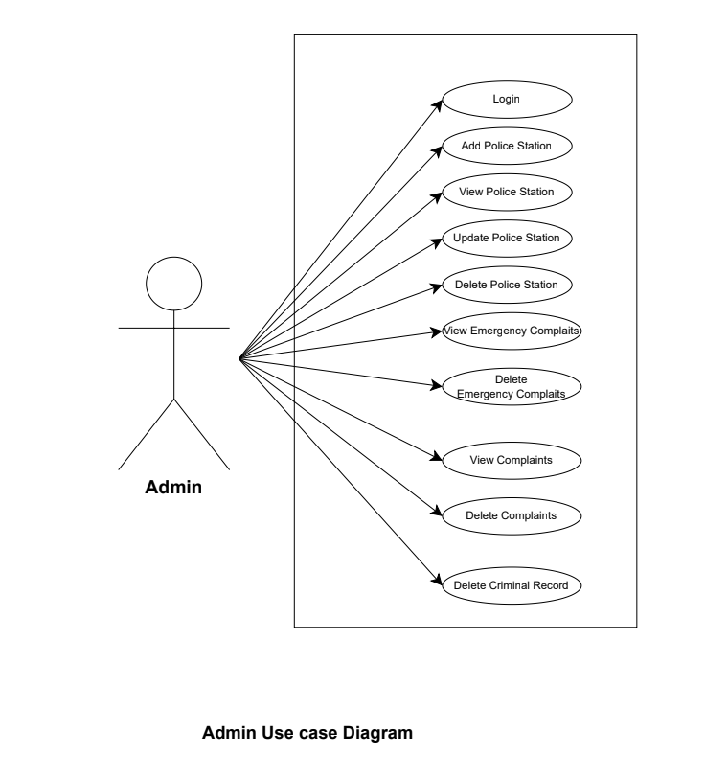
Use Case Diagram

Slide 13
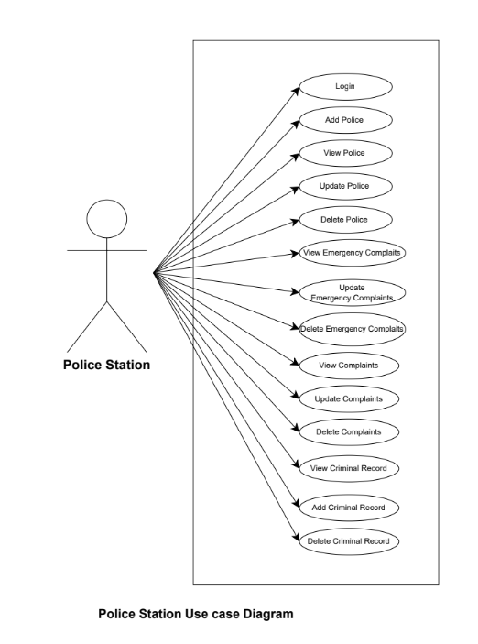
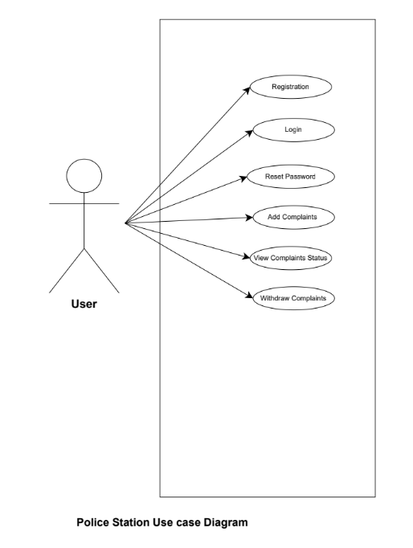

Slide 14
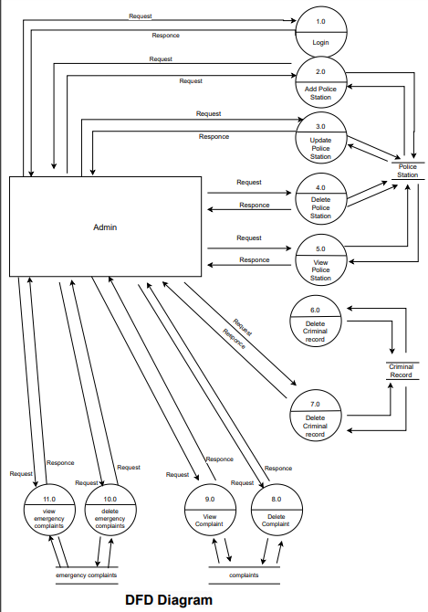
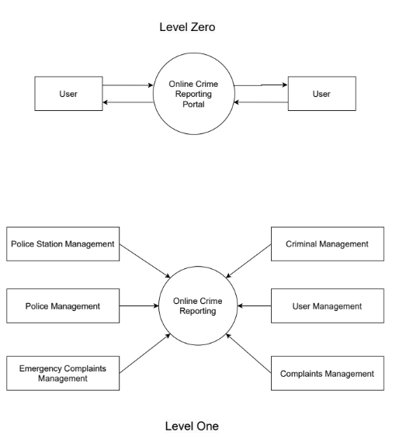
DFD Diagrams
DFD- Admin

Slide 15
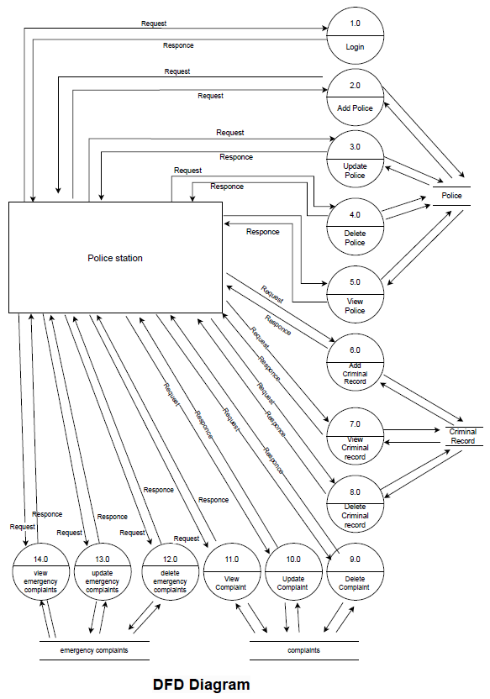
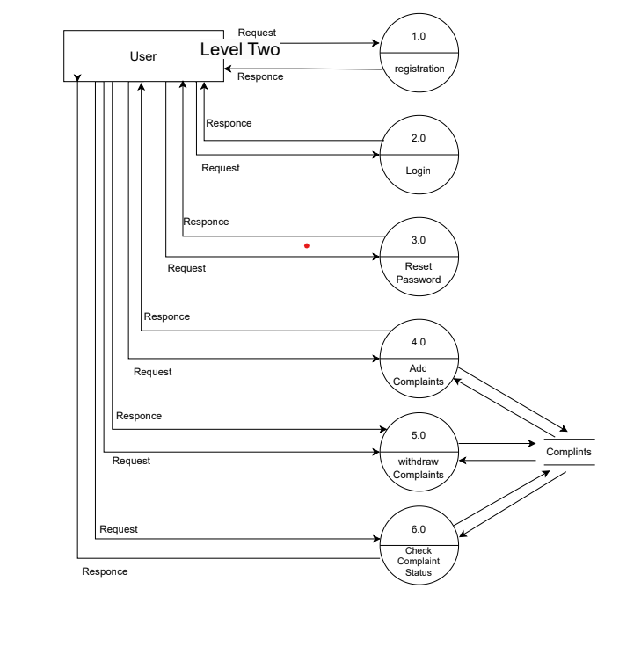
DFD For User

Slide 16
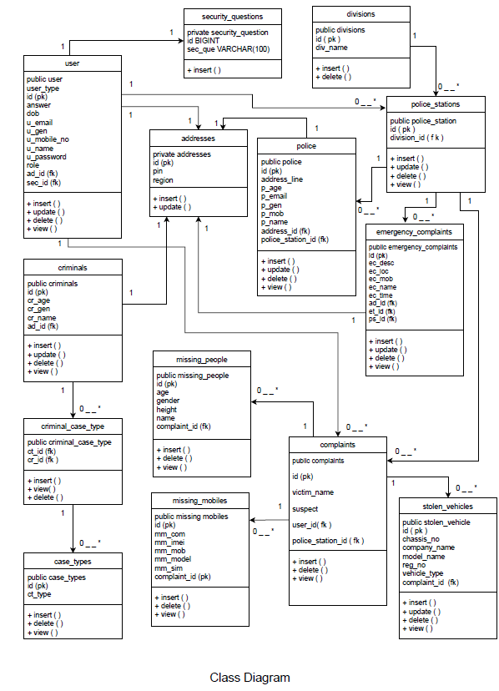
Class Diagrams

Slide 17
UI Screenshots

Slide 18
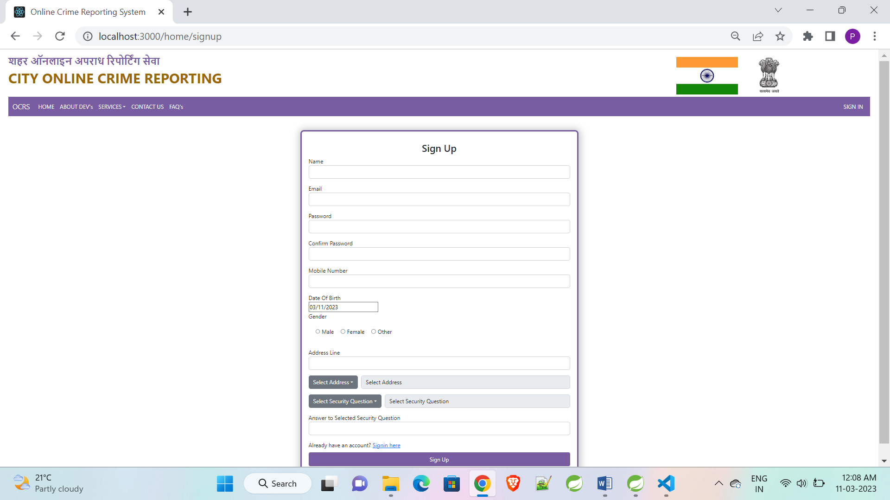
Sign up

Slide 19
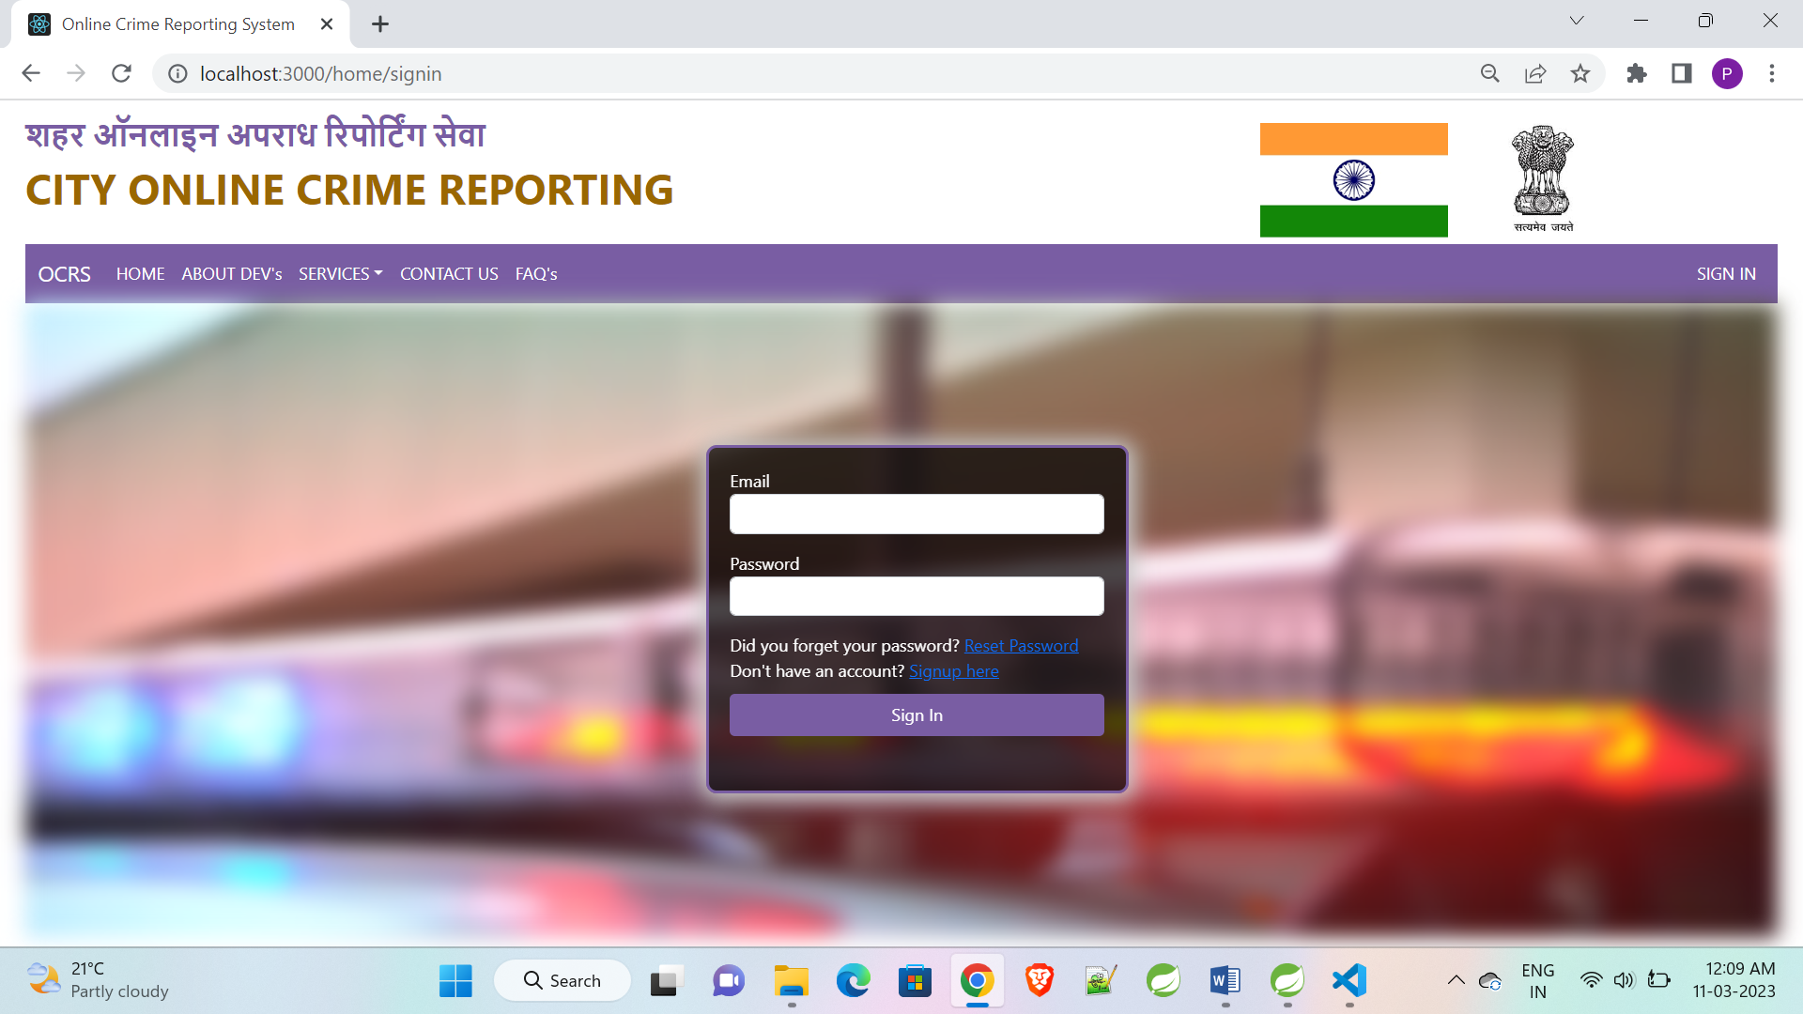
Sign in

Slide 20
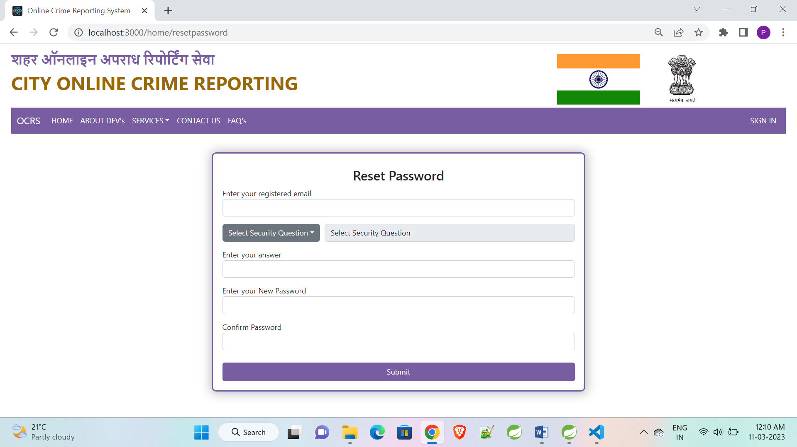
Reset Password

Slide 21
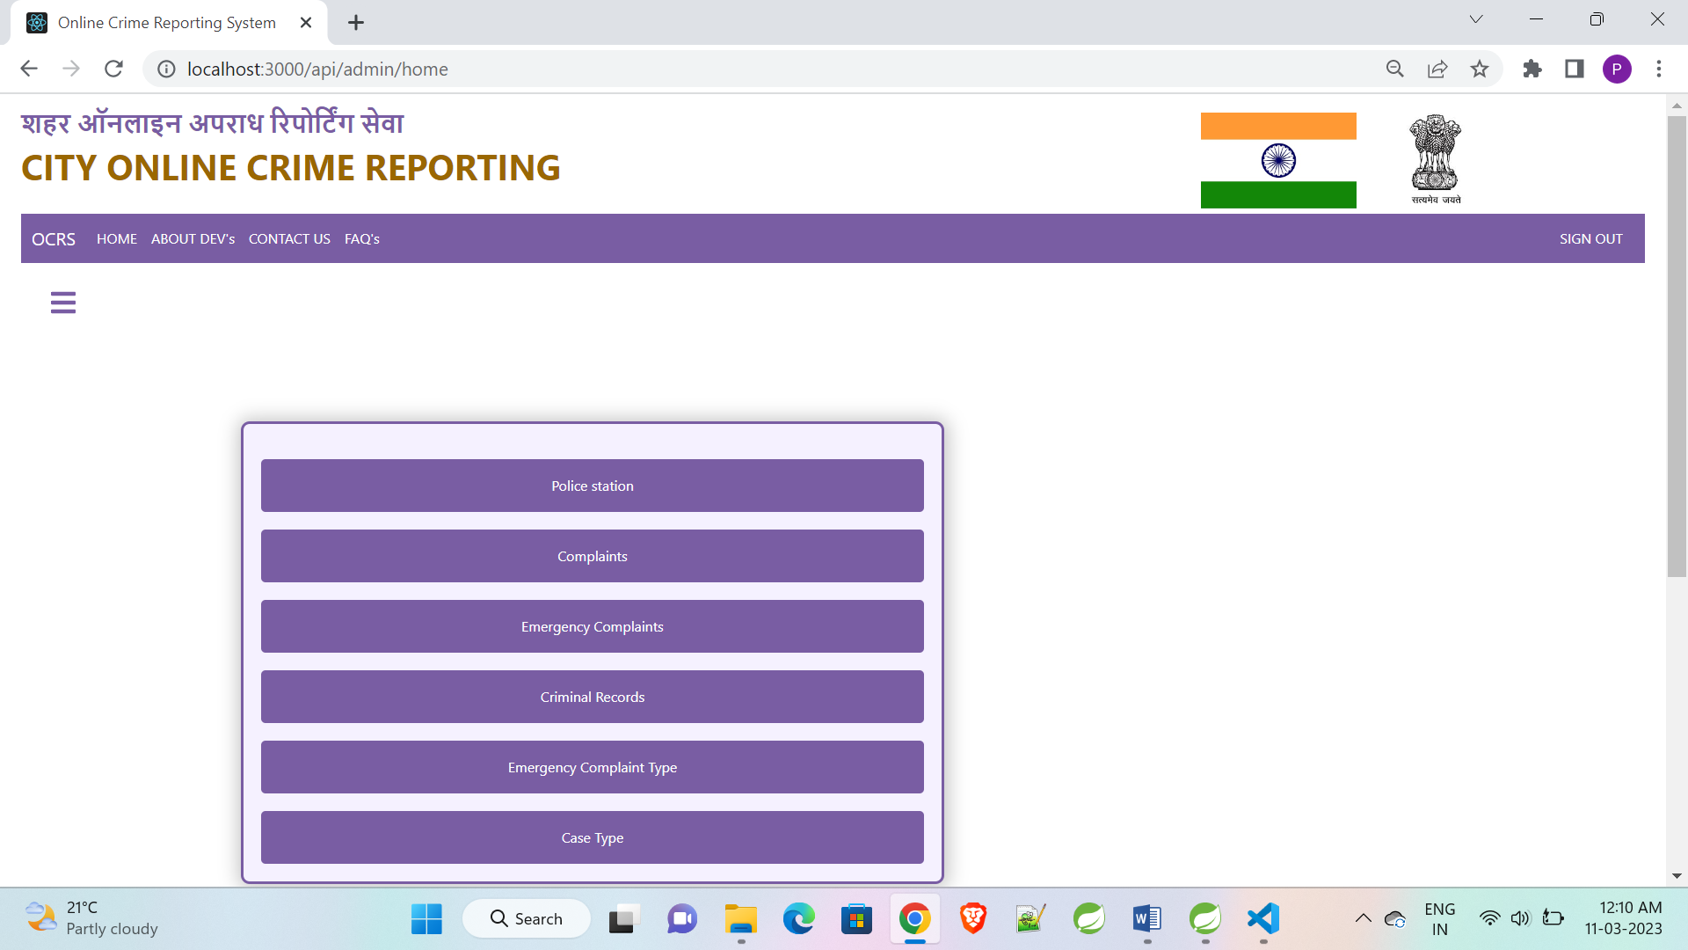
Admin Home

Slide 22
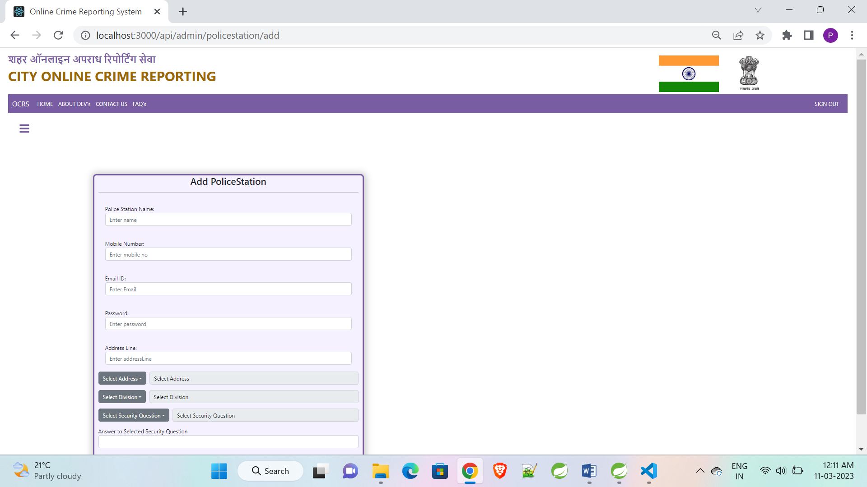
Admin Police Station Registration

Slide 23
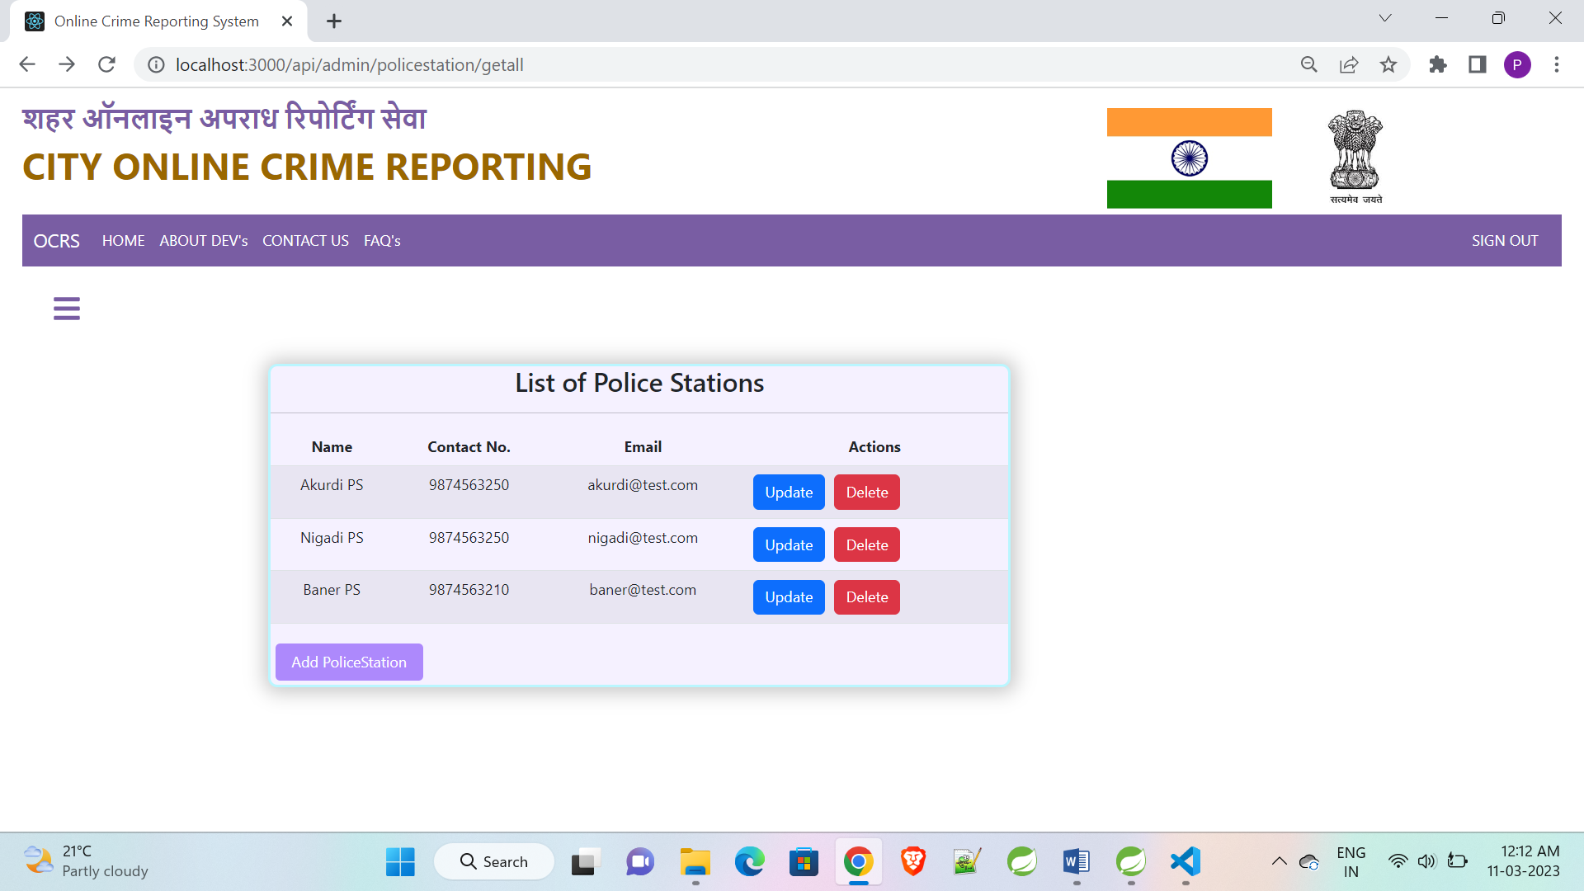
Admin Police Station List

Slide 24
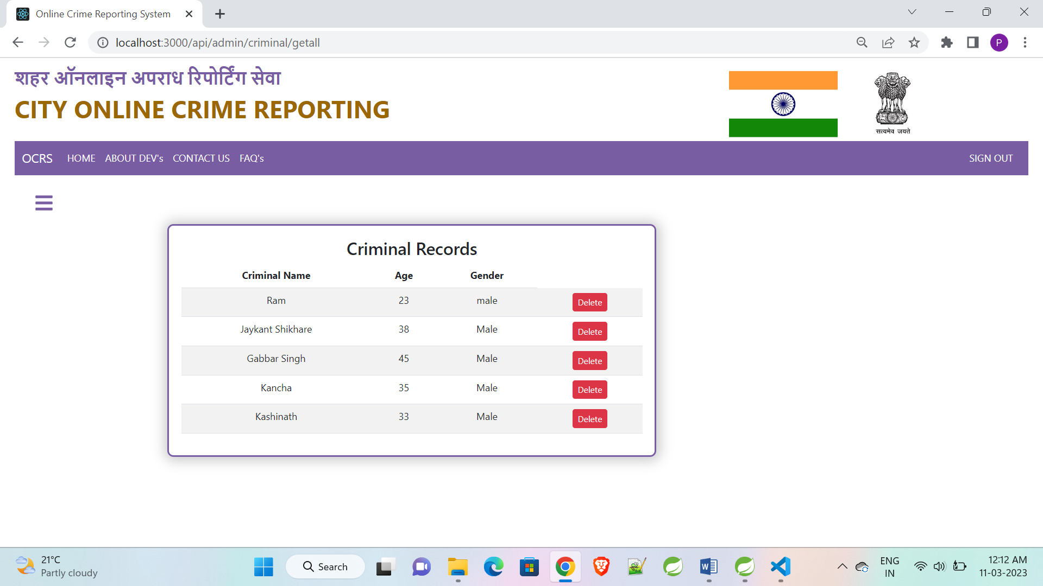
Admin Criminal List

Slide 25
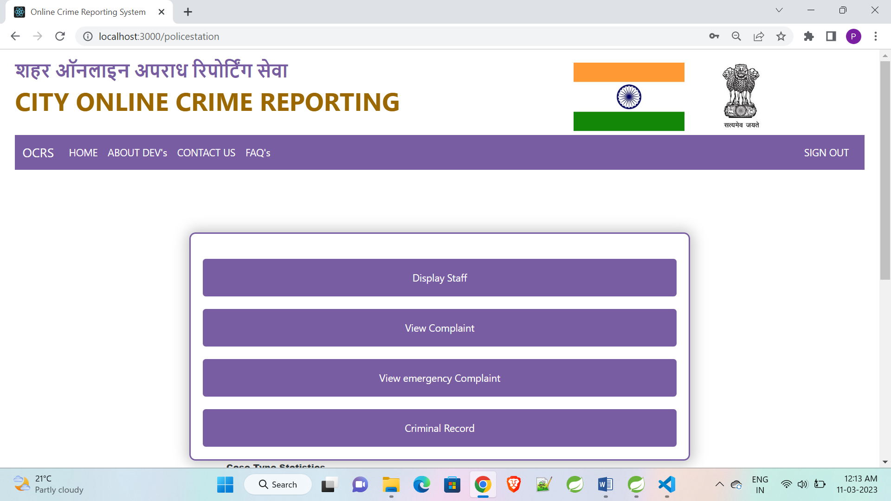
Police Station Home

Slide 26
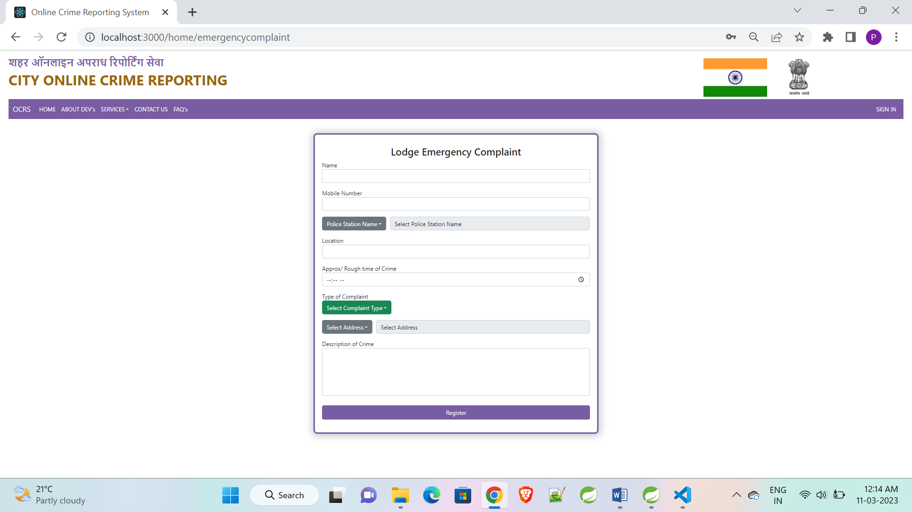
Register Emergency Complaint

Slide 27
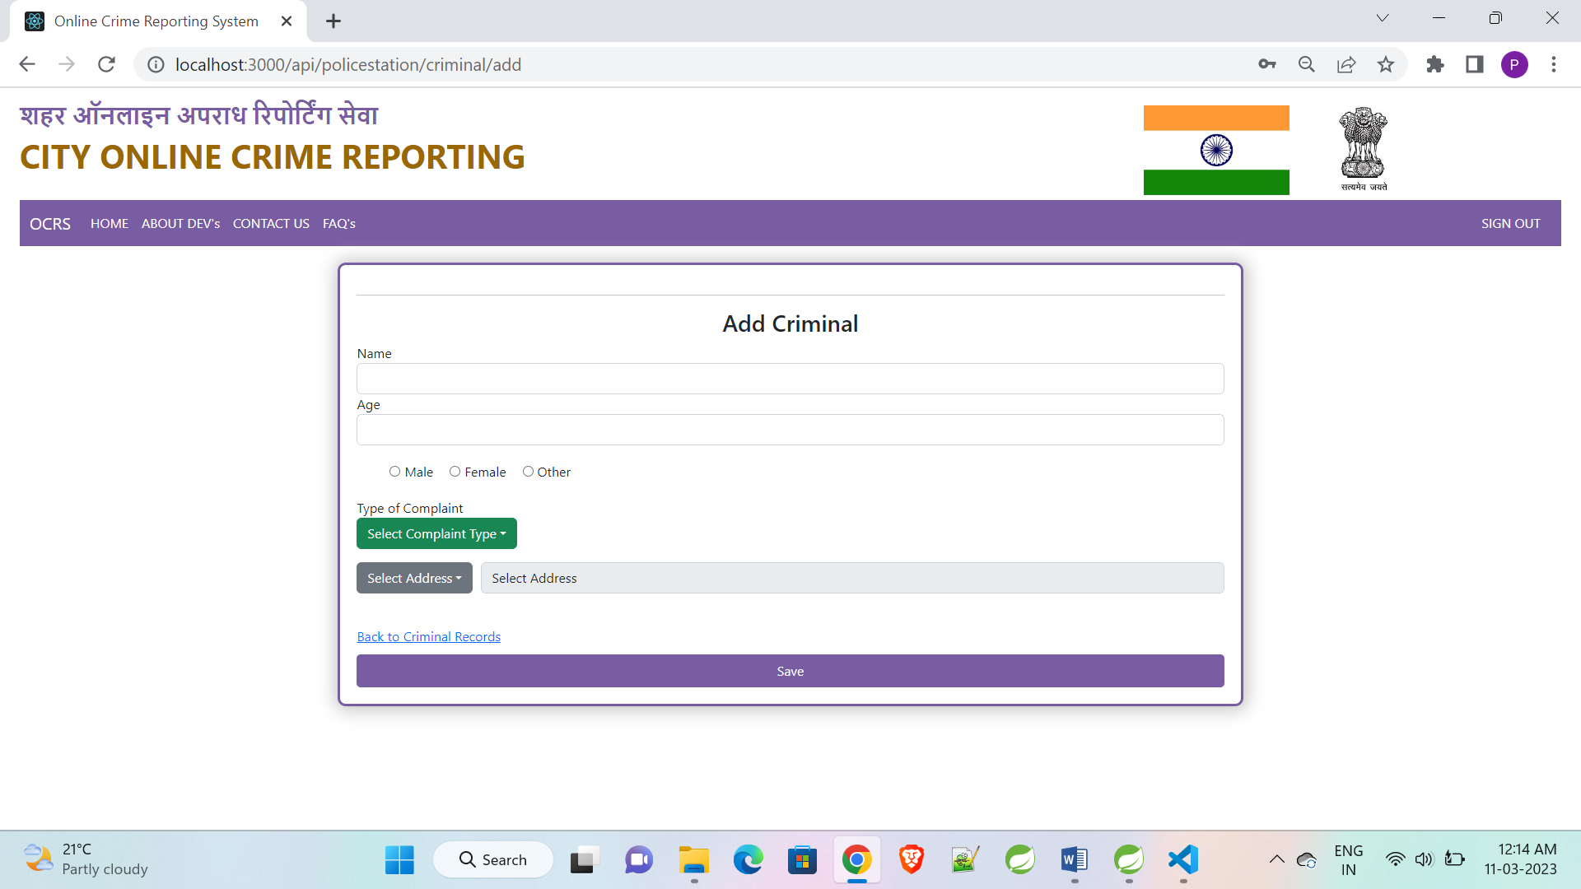
Police Station Add Criminal

Slide 28
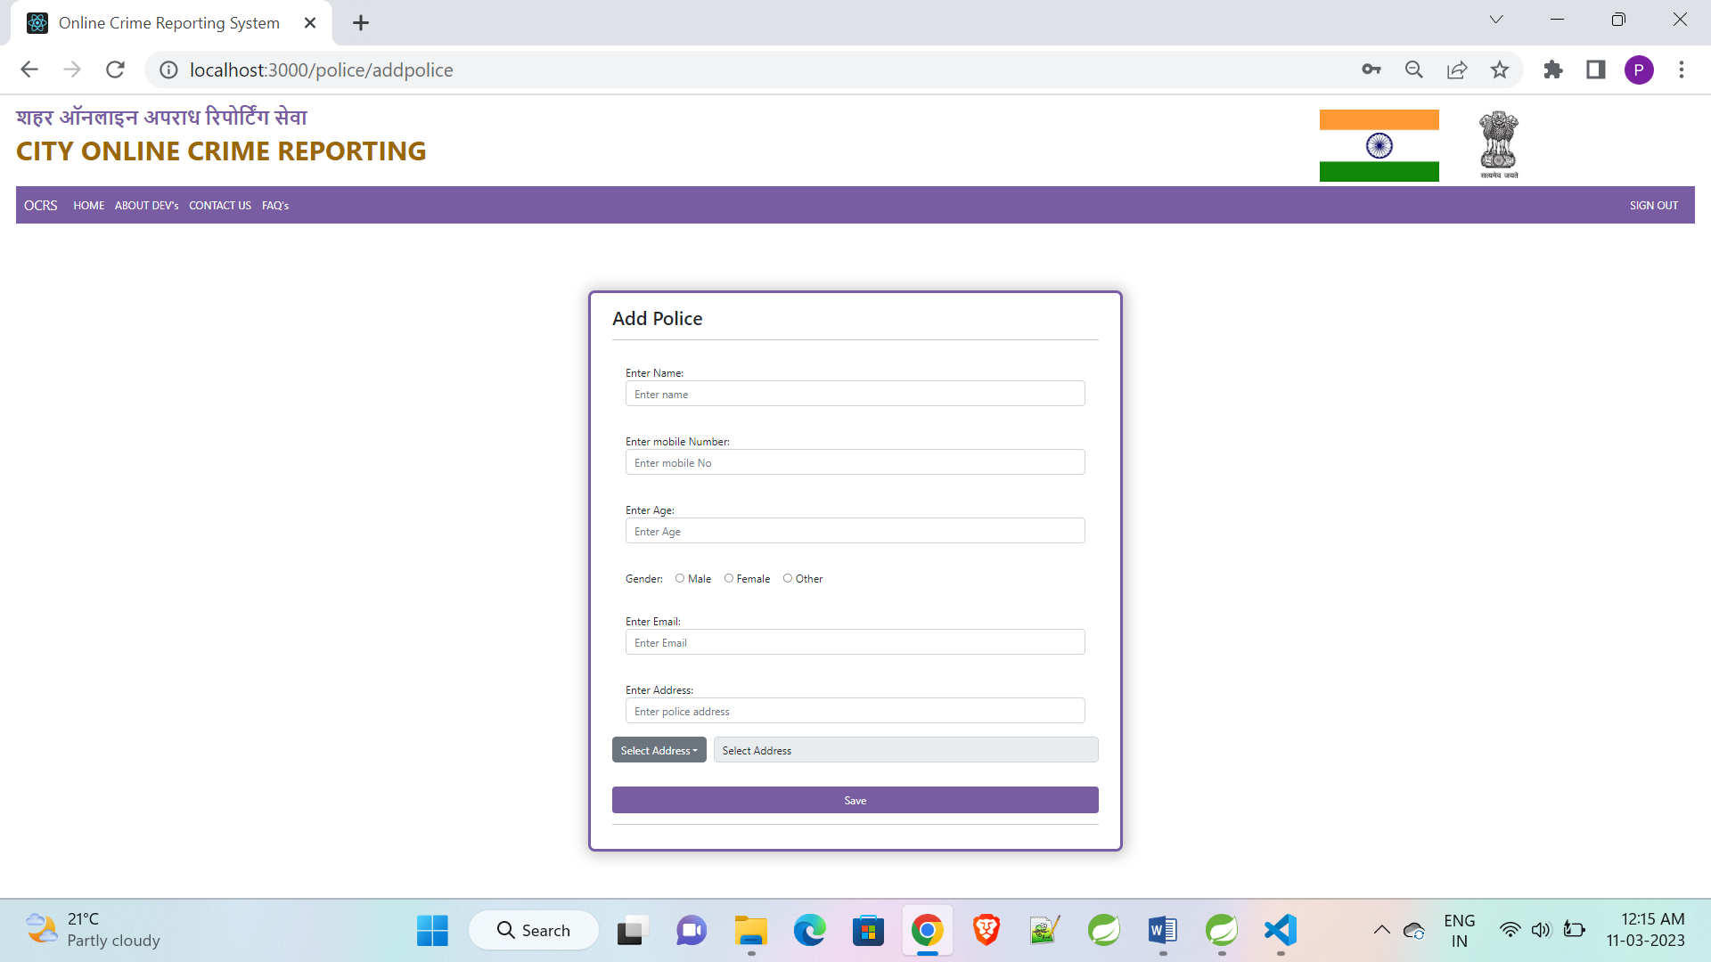
Police Station Add Police

Slide 29
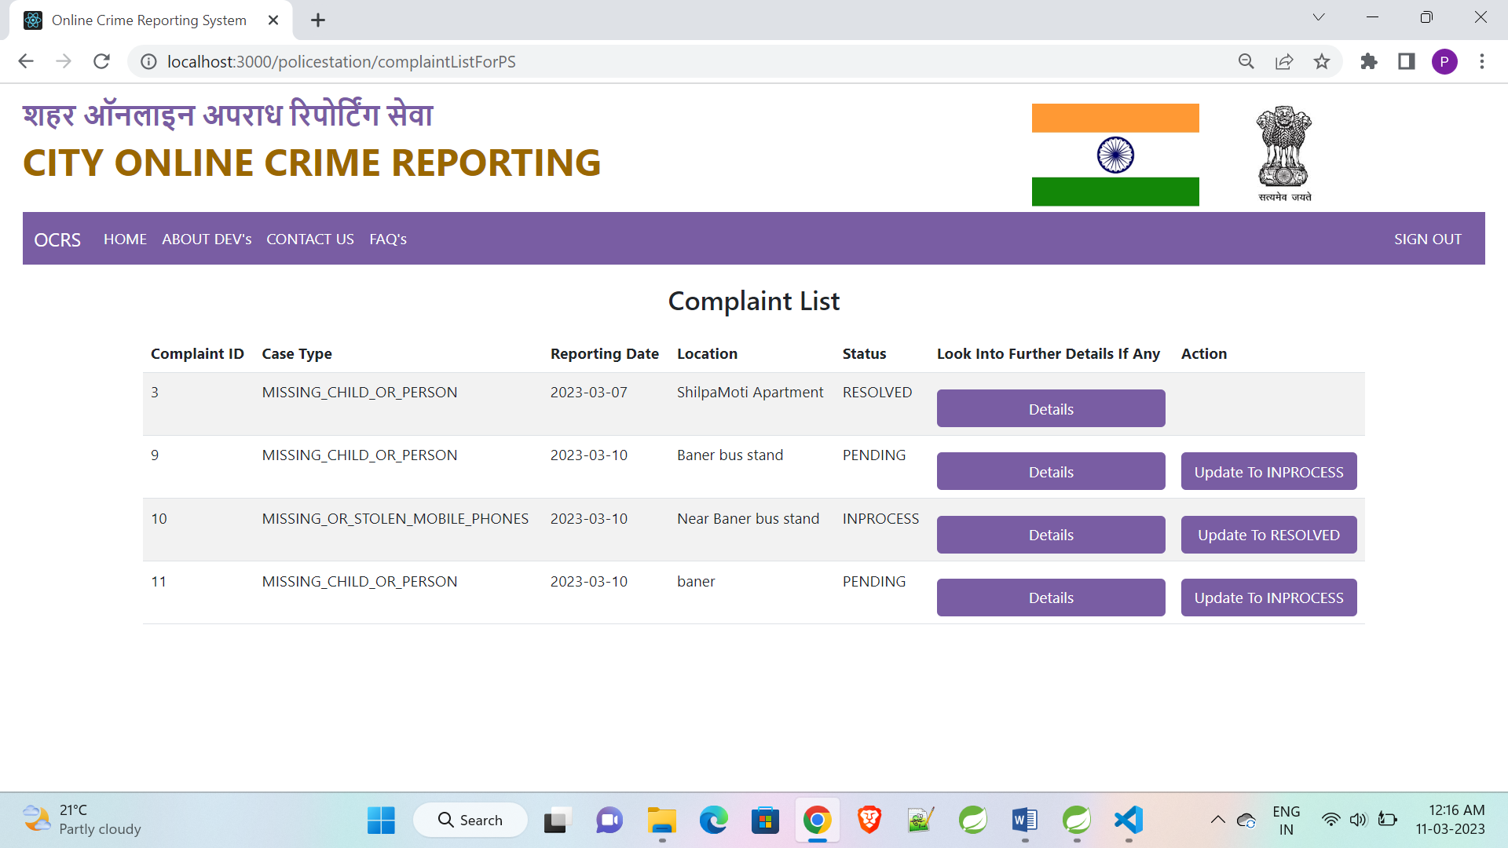
Complaint List

Slide 30
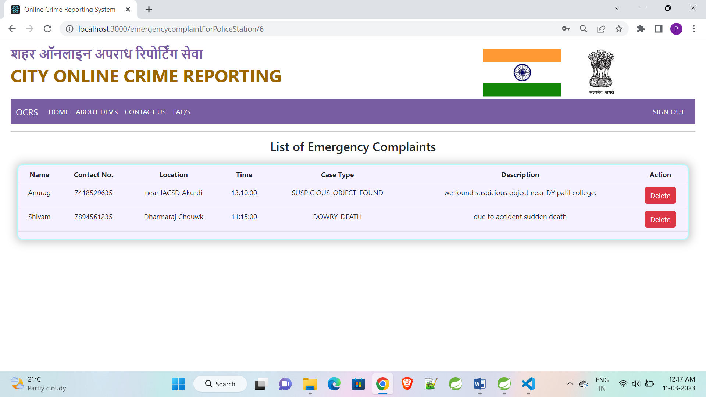
Emergency Complaint List

Slide 31
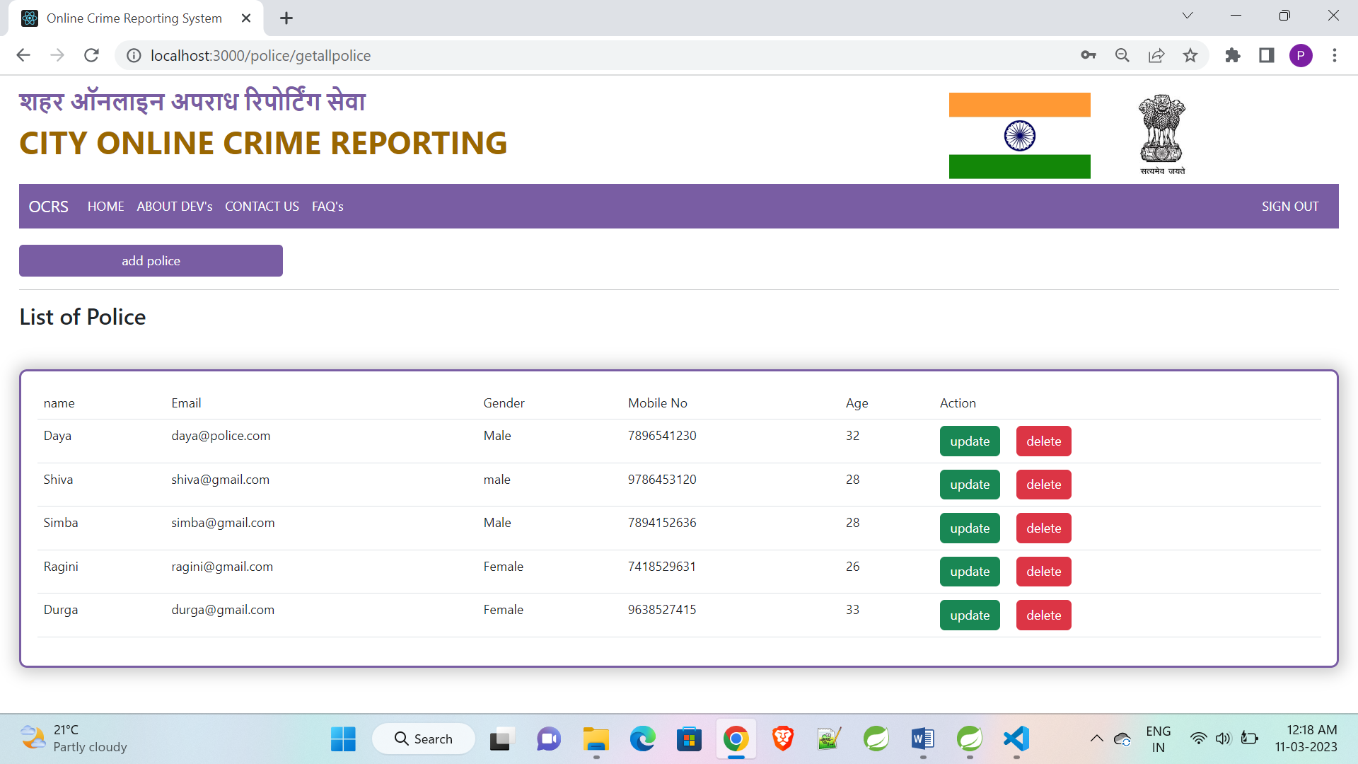
Police List

Slide 32
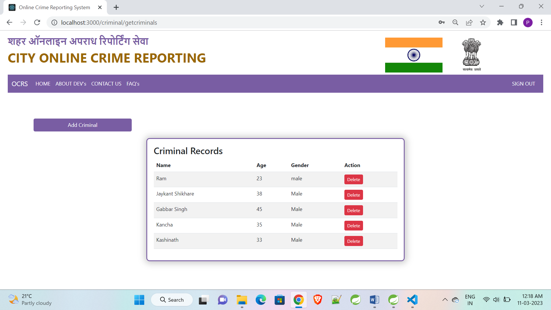
Police Criminal List

Slide 33
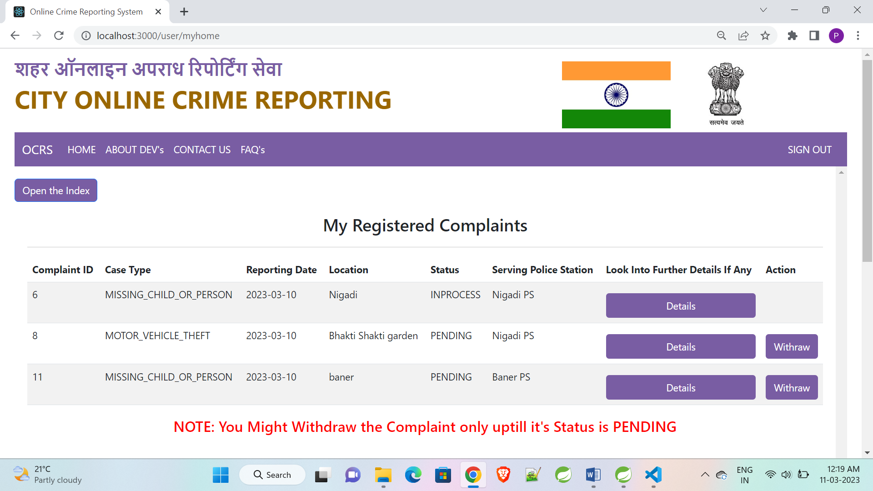
User Home

Slide 34
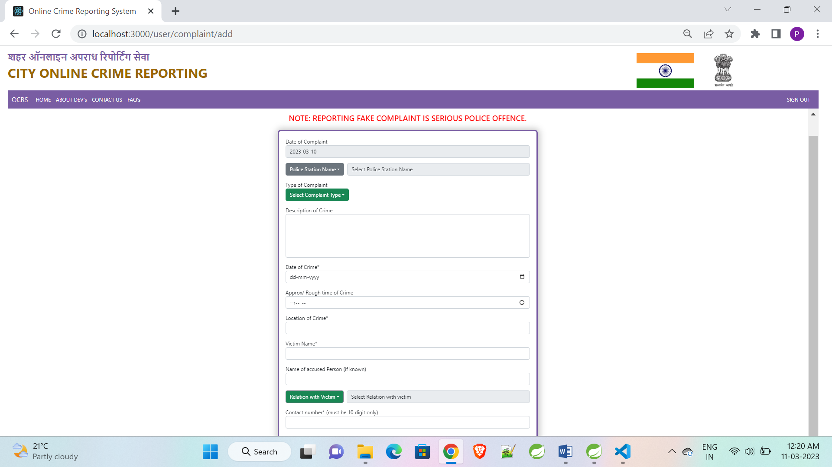
User Complaint registration

Slide 35
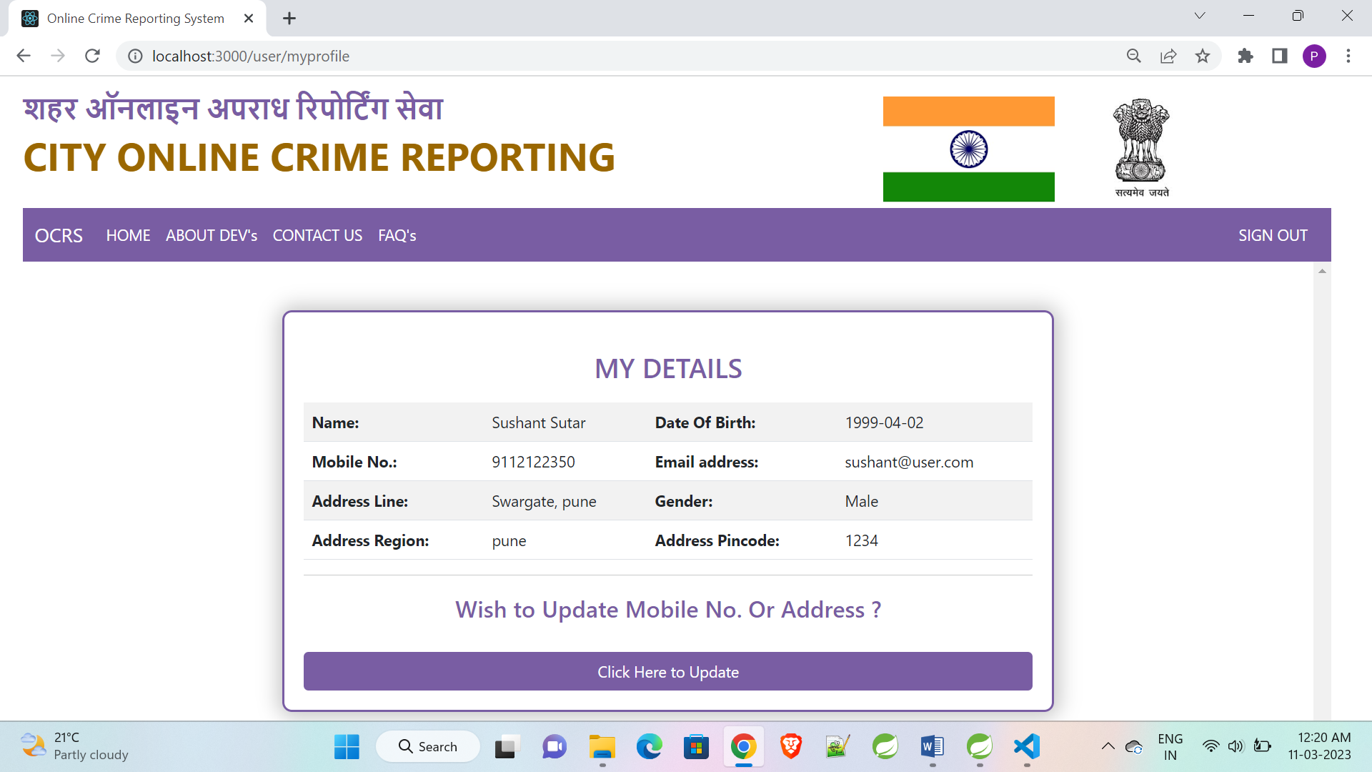
User Profile

Slide 36
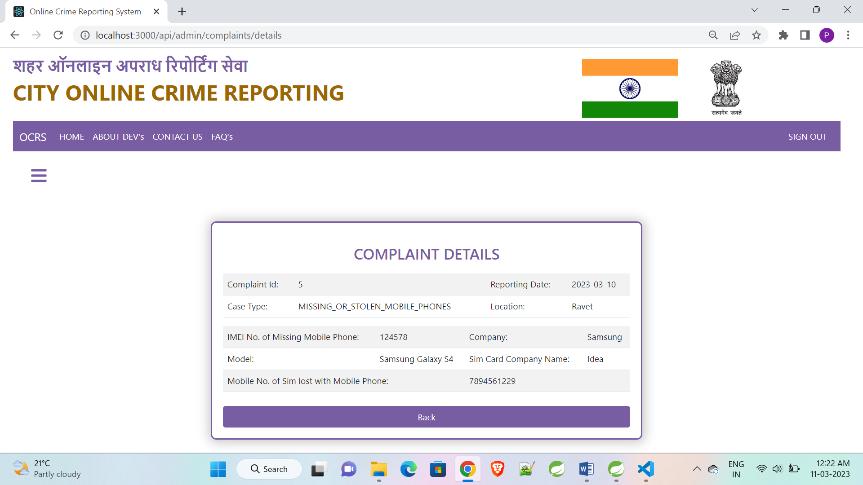
User Complaint Details

Slide 37
S/W And H/W Requirements
Hardware Interfaces
The OCRS is expected to function on Intel PIII 900 MHz Processor equivalent or above, 128 MB RAM, 20 GB HDD.
Software Interfaces
The OCR shall work on MS Windows operating systems family (MS Windows 98, MS Windows NT Workstation, MS Windows 2000, MS Windows XP). It configures to work with MySQL database. This System works on Apache Tomcat server. It uses browser IE 5.0 & above. It uses IIS 5.0 server.

Slide 38
Advantages
Managing city level crime reporting.
Effortless communication.
Easy To Access, Less maintains.
Time Saving and more effective.
All requirement in single platform.
Disadvantages
No checking for crime really happened, until police cross check.
There can be fake users can fill unwanted information.

Slide 39
Conclusion
The online crime reporting system is a web application and helps the people to register all type of complaints in a single web site with many features and easy to use and simple with the non-complex approach. And from police station purpose easy to get connected with end users.

Slide 40
Future Enhancement
From police side to user side notifications provider
Informing user about criminals and recent or most frequently happened crimes with statistics.
Making strong and powerful web site.

Slide 41
References
http://www.google.com
https://www.w3schools.com/
https://docs.spring.io/spring-framework
https://react-bootstrap.netlify.app/components/navbar
https://stackoverflow.com
https://delhipolice.nic.in/

Slide 42

Thank You…..!!!!!

